Slide 1
Review for midterm

Slide 2
Key points
Number conversion
2’s complement
Addition, subtract, overflow
Boolean expressions.
Draw circuit diagram using Boolean expressions
Simplification theorems
Prove the validity
Truth table
Exclusive OR
Sum-of-Product and minterms
Use Boolean expression to specify a system
Use K-map to simplify the Boolean expressions

Slide 3
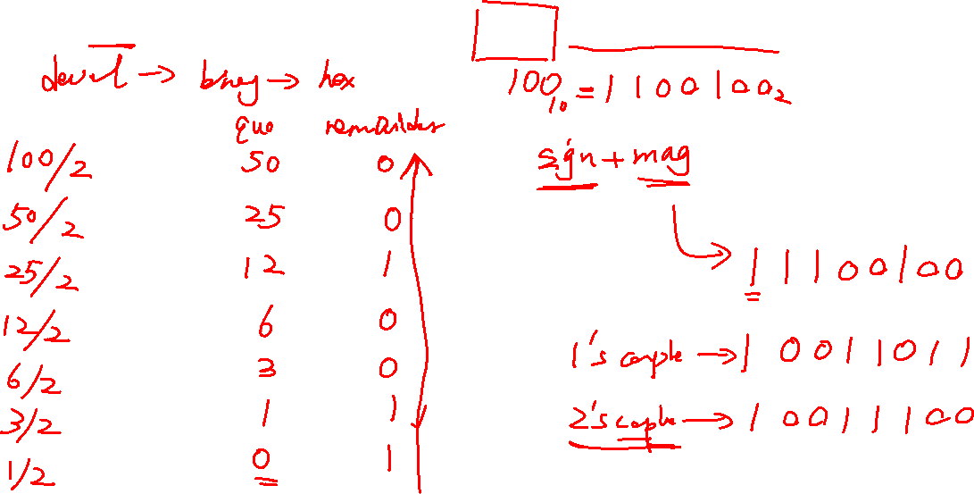
Number conversion & 2’s complement
Convert -100 from base-10 to hexadecimal(16 bits two’s complement notation).

Slide 4
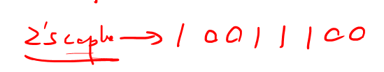
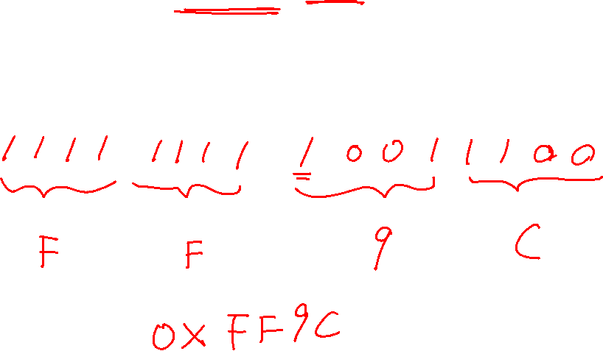
Number conversion & 2’s complement
Convert -100 from base-10 to hexadecimal(16 bits two’s complement notation).

Slide 5
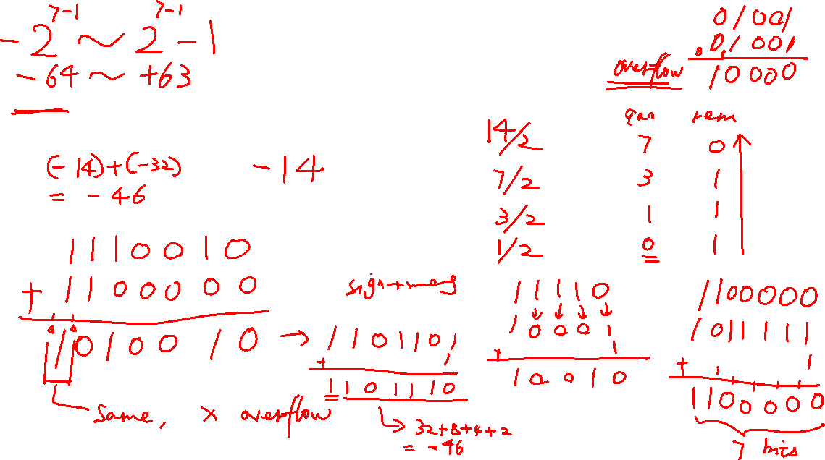
Addition, subtract, overflow
Use 7 bits 2’s complement to represent the following numbers and compute the result,
determine if there’s an overflow.
-14-32.

Slide 6
Addition, subtract, overflow
Use 7 bits 2’s complement to represent the following numbers and compute the result,
determine if there’s an overflow.
-14-32.

Slide 7
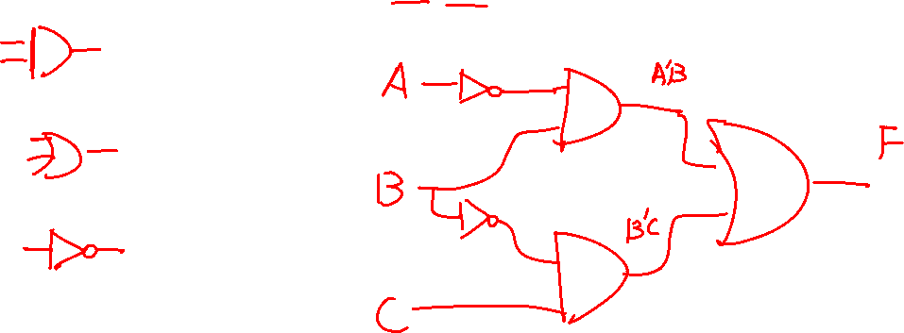
Logic gates and circuit diagram
Draw the circuit diagram of F(A,B,C)=A’B+B’C using the AND, OR and NOT gates.

Slide 8
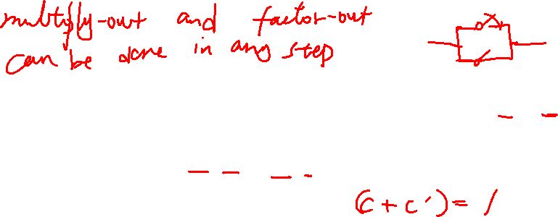
Algebraic Simplification Procedures
Combining Terms:
1. Combining terms. Use the theorem XY + XY’ = X to combine two terms. For example,
abc'd’ + abcd’ = abd’ [X = abd’, Y = c] (3-24)
When combining terms by this theorem, the two terms to be combined should contain exactly the same variables, and exactly one of the variables should appear complemented in one term and not in the other. Because X + X = X, a given term may be duplicated and combined with two or more other terms. For example,
ab'c + abc + a’bc = ab’c + abc + abc + a’bc = ac + bc

Slide 9
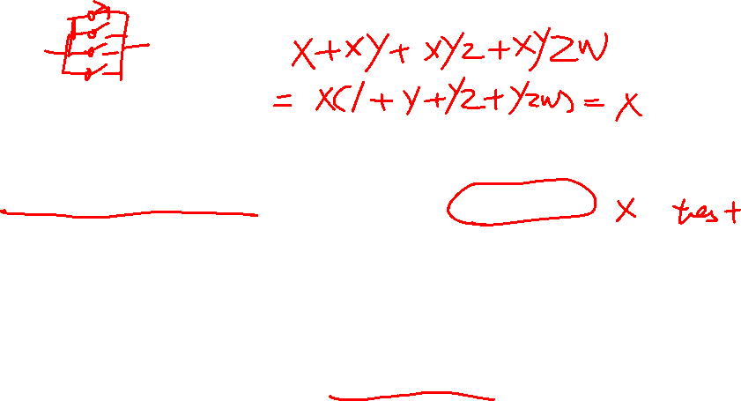
Algebraic Simplification Procedures
Eliminating Terms and Literals:
2. Eliminating terms. Use the theorem X + XY = X to eliminate redundant terms if possible; then try to apply the consensus theorem (XY + X’Z + YZ = XY + X’Z) to eliminate any consensus terms. For example,
a'b + a‘bc = a‘b [X = a‘b]
a'bc’ + bcd + a’bd = a’bc’ + bcd [X = c, Y = bd, Z = a’b] (3-25)
3. Eliminating literals. Use the theorem X + X’Y = X + Y to eliminate redundant literals. Simple factoring may be necessary before the theorem is applied.

Slide 10
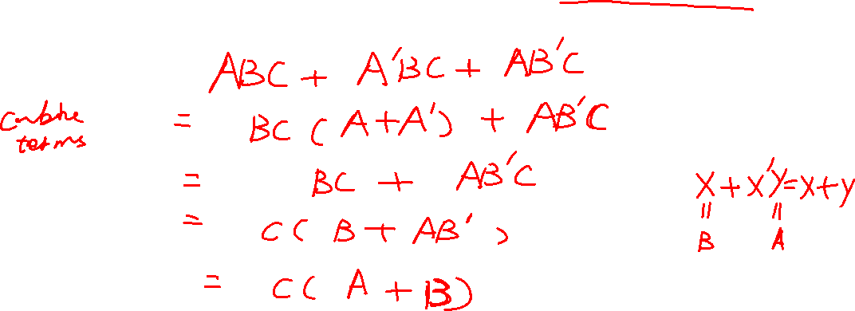
Simplification theorems
Simplify the circuit: F(A,B,C)=ABC+A’BC+AB’C. The results only have three literals.

Slide 11
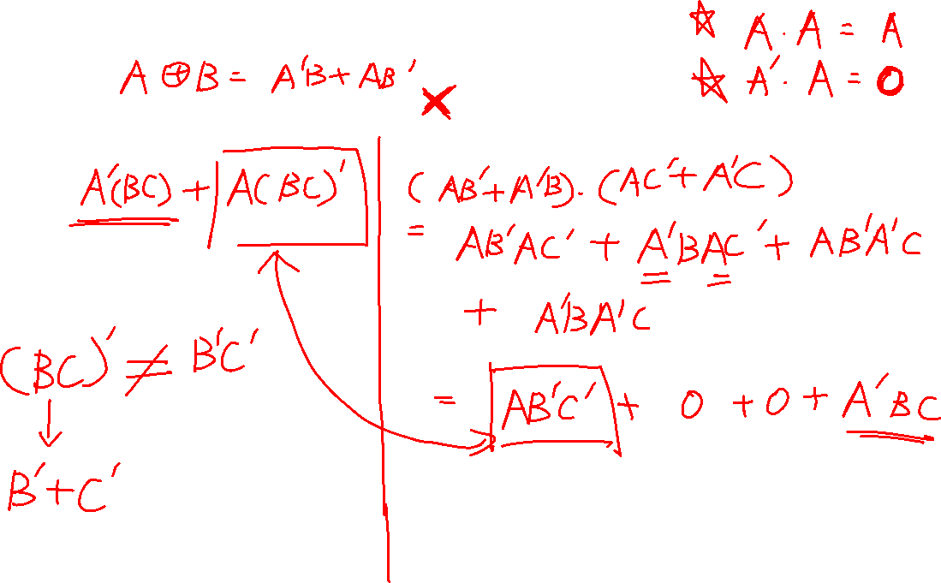
Prove the validity & XOR
Is the following distributive law valid? A⊕BC=(A⊕B)(A⊕C)

Slide 12
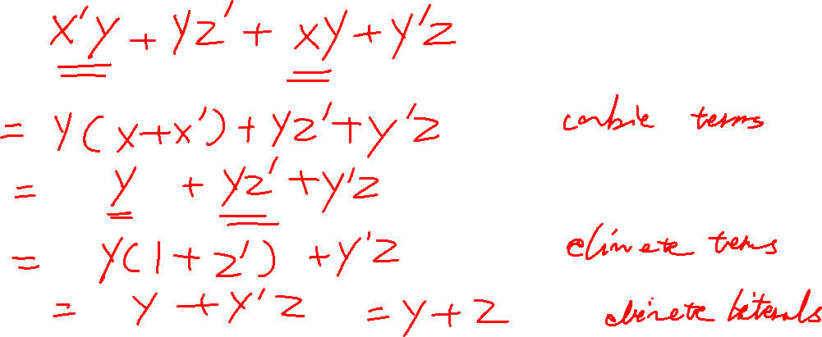
Simplification theorems
Reduce to a minimum sum of products(answer only has two literals):
Y(X’+Z’)+(XY+Y’Z)

Slide 13

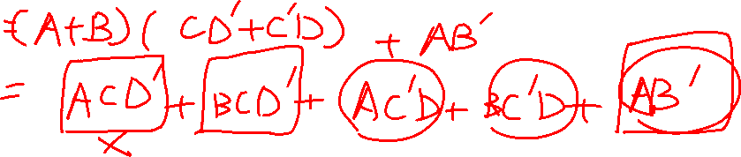
Simplification theorems
Reduce to a minimum sum of products:
(A+B)(C⊕D)+AB’

Slide 14
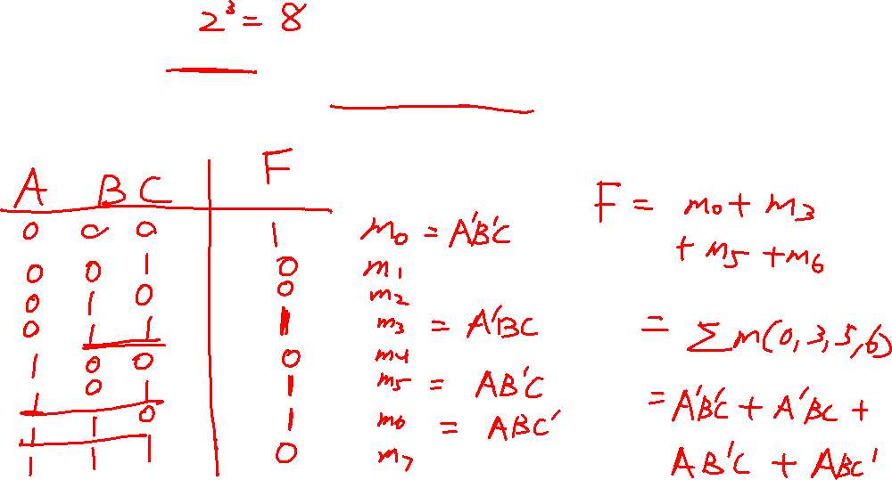
Truth table & Use Boolean expression to specify a system
There are three input signals A, B, C. If three inputs are 0 at the same time
or only two signals are 1 at the same time, the output F is 1, otherwise, F is 0.
Build its truth table

Slide 15
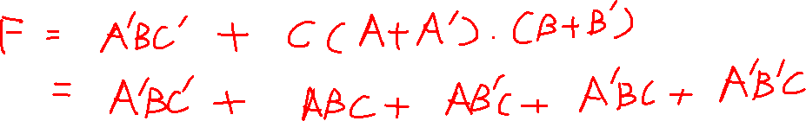
Sum-of-Product and minterms
Given F(A,B,C)=A’BC’+C.
Express F as a minterm expansion.

Slide 16
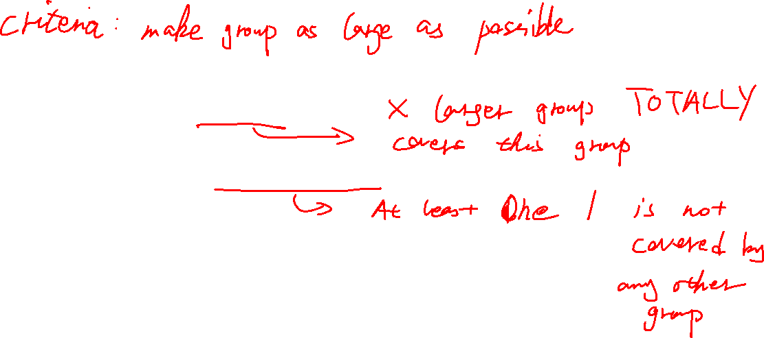
Determination of Minimum Expressions Using Essential Prime Implicants
Procedure to Obtain a Minimum Sum of Products from a Karnaugh Map:
Find all prime implicants
Include all essential prime implicants
Include other prime implicants to cover all minterms not yet covered. Try to minimize the overlap between the prime implicants

Slide 17
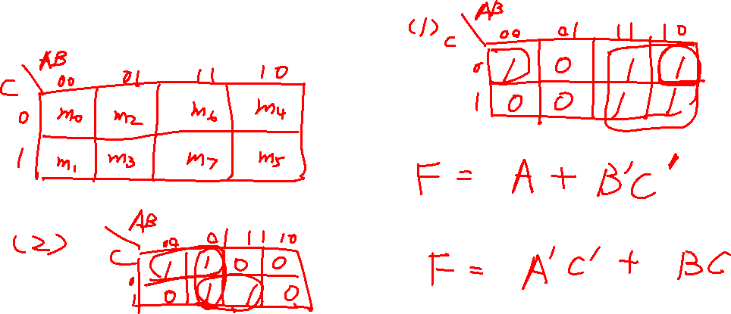




Use K-map to simplify the Boolean expressions
Use K-map to simplify the following functions:
F(A,B,C)= Σm(0,4,5,6,7)
F(A,B,C)=Σm(0,2,3,7)

Slide 18


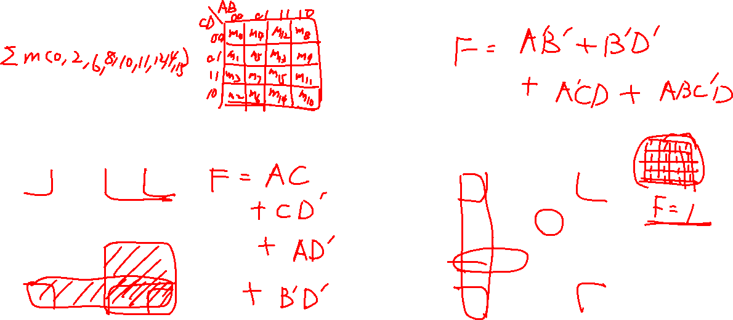


Use K-map to simplify the Boolean expressions
A
A
AB
CD 00 01 11 10
AB
CD 00 01 11 10
1 | 0 | 1 | 1
0 | 0 | 0 | 0
0 | 0 | 1 | 1
1 | 1 | 1 | 1
1 | 0 | 0 | 1
1 | 0 | 1 | 0
1 | 1 | 0 | 0
1 | 0 | 0 | 1
00
01
00
01
D
D
11
C
10
B
11
C
10
B

